Slide 1
Antarctica is a unique continent
Antarctica is the only continent with no permanent human habitation. There are, however, permanent human settlements, where scientists and support staff live for part of the year on a rotating basis. The Antarctic Ice sheet dominates the region. It is the largest single piece of ice on Earth. Antarctica is the coldest place in the world. The lowest temperature ever recorded in Antarctica was - 89.6 C. Antarctica is a huge continent. It’s approximately 48 times the size of the UK and twice as big as Australia. It has over 90% of the world’s ice and 70% of its fresh water. In some places, its ice is over 3 km thick.
The average height of this continent is more than 2000 meters above sea level. The height of the continent's central part is more than 4000 meters above sea level. And the highest point the mountain group Vinson is 4892 meters above sea level. The lowest point of Antarctica is the Bentley Cavity that is 2555 meters below sea level.

Slide 2
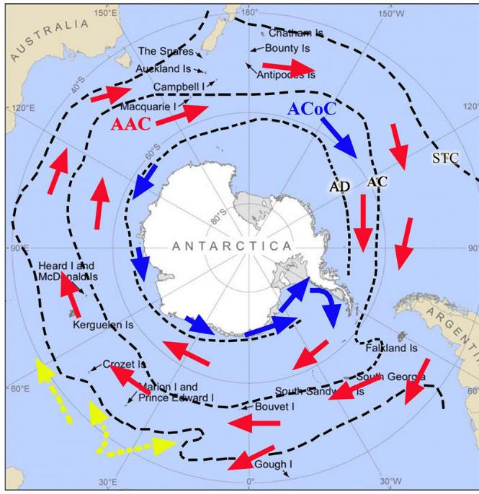
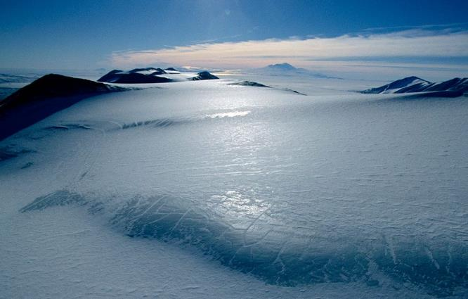
The role of Antarctica
The Antarctic region has an important role in global climate processes. It is an integral part of the Earth’s heat balance. The heat balance, also called the energy balance, is the relationship between the amount of solar heat absorbed by Earth’s atmosphere and the amount of heat reflected back into space. Antarctica has a larger role than most continents in maintaining Earth’s heat balance. Ice is more reflective than land or water surfaces. The massive Antarctic ice sheet reflects a large amount of solar radiation away from Earth’s surface. As global ice cover decreases, the reflectivity of Earth’s surface also decreases. This allows more incoming solar radiation to be absorbed by the Earth’s surface, causing an unequal heat balance linked to global warming.
Antarctic upwelling is so strong that it helps move water around the entire planet. This movement is aided by strong winds that circumnavigate Antarctica. Without the aid of the oceans around Antarctica, the Earth’s waters would not circulate in a balanced and efficient manner.

Slide 3
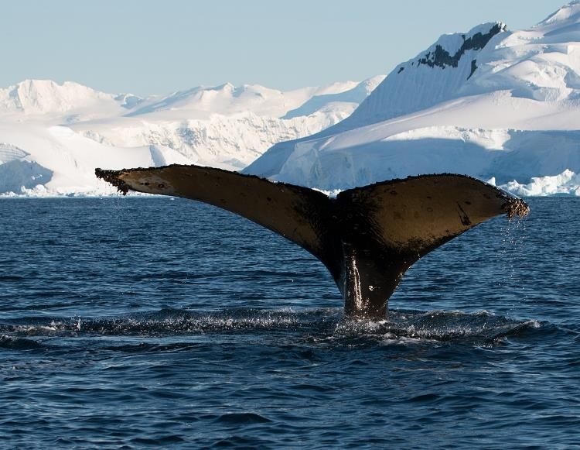
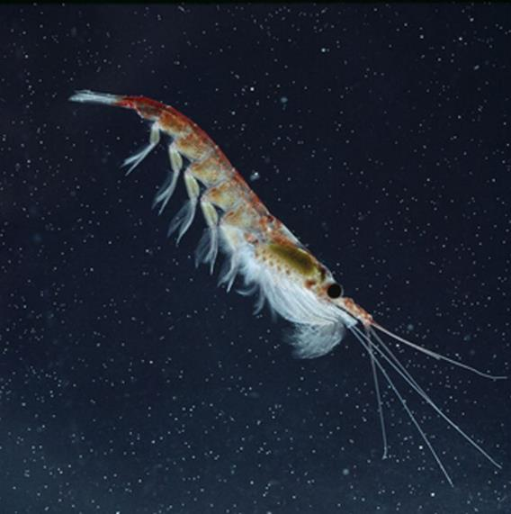
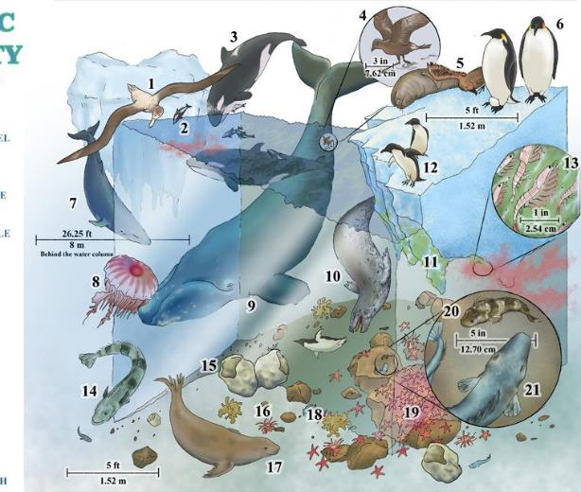
Flora and Fauna
Lichens, mosses, and terrestrial algae are among the few species of vegetation that grow in Antarctica. More of this vegetation grows in the northern and coastal regions of Antarctica, while the interior has little if any vegetation.
The ocean, however, teems with fish and other marine life. In fact, the waters surrounding Antarctica are among the most diverse on the planet. Upwelling allows phytoplankton and algae to flourish. Thousands of species, such as krill, feed on the plankton. Fish and a large variety of marine mammals thrive in the cold Antarctic waters. Different types of whales have populations in coastal waters of Antarctica.

Slide 4
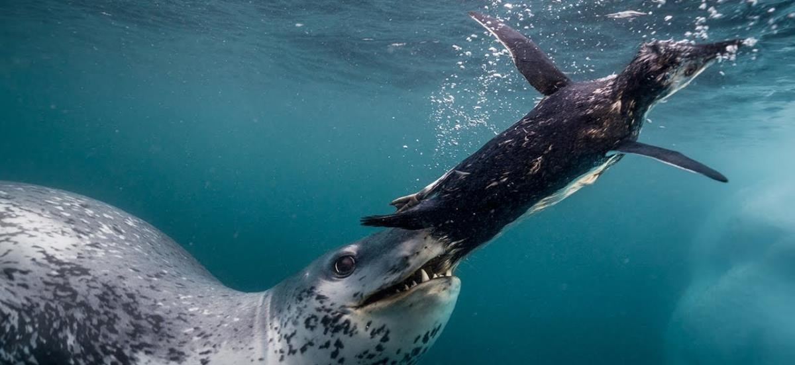
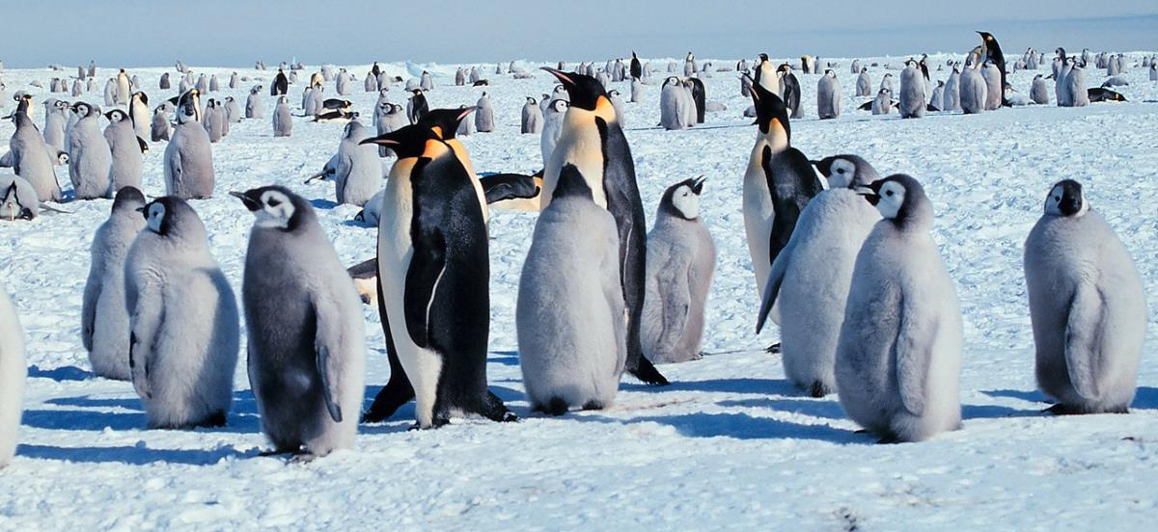
Flora and Fauna
One of the top predators in Antarctica is the leopard seal. The leopard seal is one of the most aggressive of all marine predators. This 3-meter, 400-kilogram animal has unusually long, sharp teeth, which it uses to tear into prey such as penguins and fish.
The most familiar animal of Antarctica is probably the penguin. They have adapted to the cold, coastal waters. Their wings serve as flippers as they “fly” through the water in search of prey such as squid and fish. Their feathers retain a layer of air, helping them keep warm in the freezing water.

Slide 5
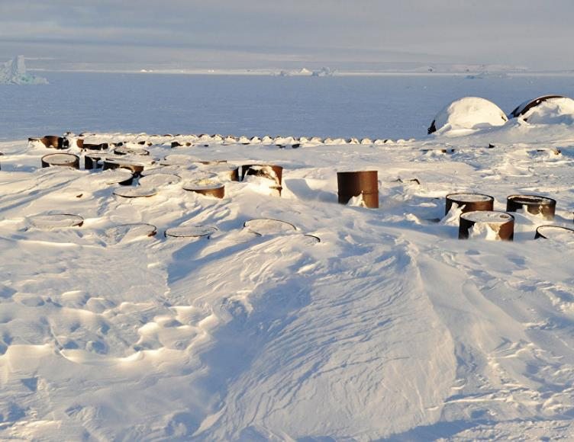
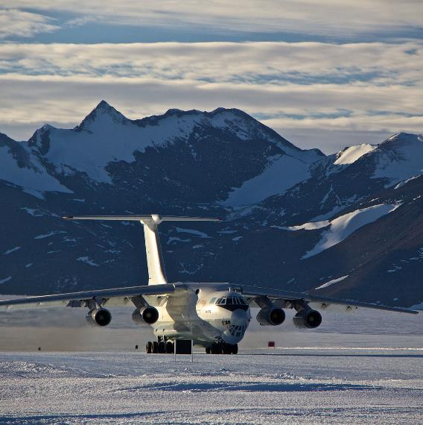
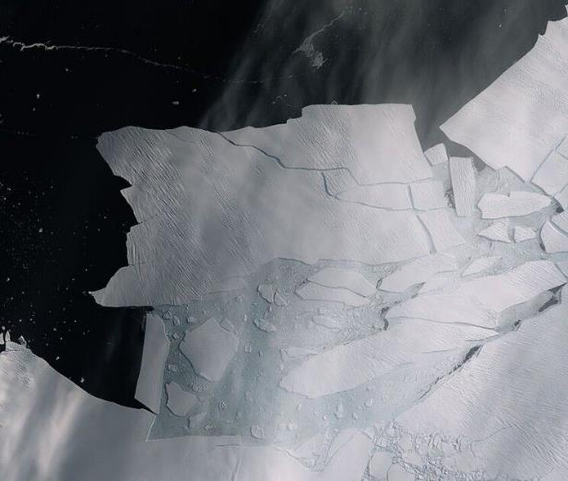
To protect Antarctica
What is being done to protect the unique animal world of Antarctica
In 1959, 12 countries signed the Antarctic Territorial Delimitation Treaty. All countries claimed that they wanted to use Antarctica for peaceful and scientific purposes. In fact, however, not everyone understood the importance of the region to the entire planet and actually destroyed the local nature. There were a lot of examples proving that countries were not green. For instance, there were a lot of waste around the scientific stations, technical oils and dirty water spilled into the sea or just on the ice, in the 1970s a leaking US nuclear reactor caused serious environmental damage, France even built an airfield in Antarctica, having destroyed numerous penguin colonies, Japan regularly catches whales in the coastal waters of Antarctica, and many countries have uncontrolled krill fishing.

Slide 6
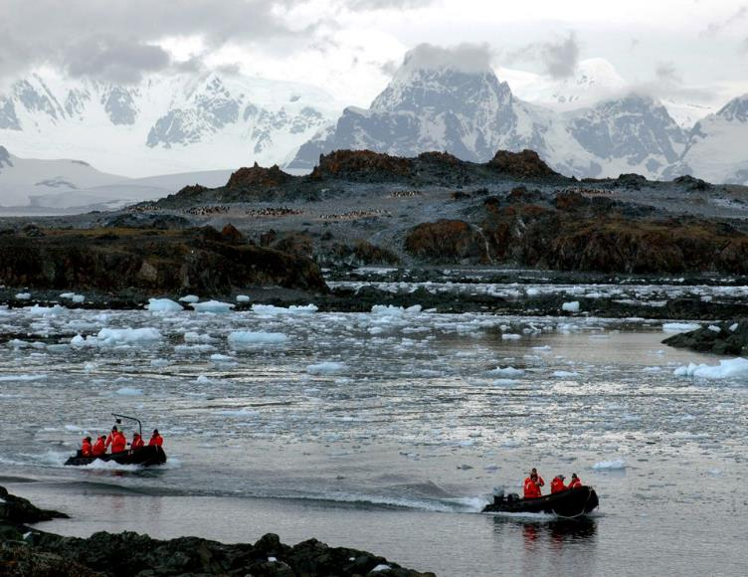
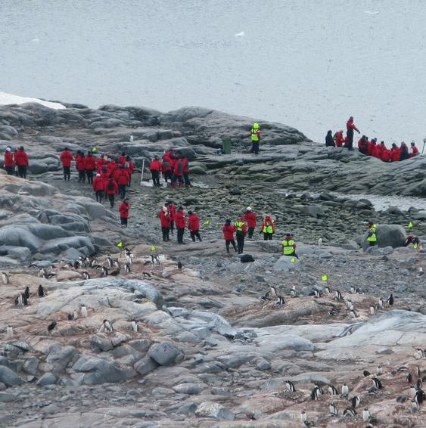
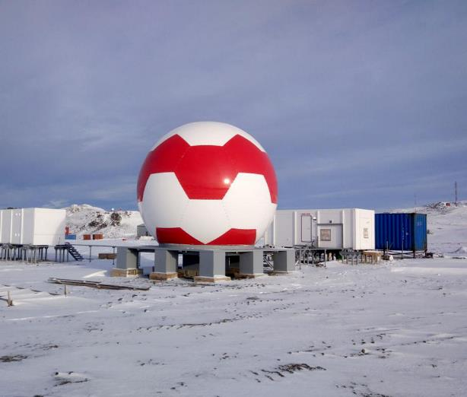
To protect Antarctica
This situation could destroy the ecology of Antarctica. Therefore, in 1972, representatives of 80 States decided that Antarctica should become a natural reserve. All countries were required to plan their activities to protect the Antarctic environment. This instrument requires environmental monitoring, environmental impact assessment of industrial, scientific and tourist activities, and the protection of flora and fauna. The Protocol regulates measures to protect flora and fauna, waste disposal, prevention of pollution of the marine and terrestrial environment, and also defines specially protected areas. The Protocol prohibits all mineral resource development activities in Antarctica. An Antarctic Environmental Protection Committee had also been established to deal with all contentious issues and to inspect the activities of States in Antarctica. By 1991, the Protocol had been ratified by all countries and entered into force.

Slide 7
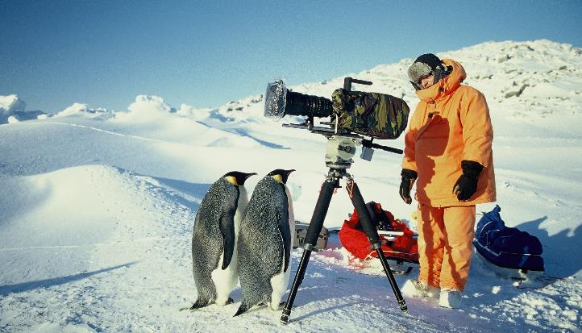
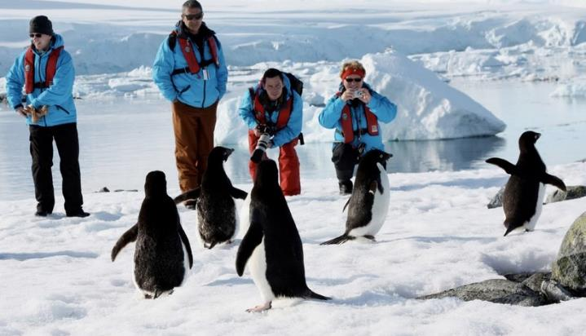
To protect Antarctica
In accordance with this protocol, in order to protect the ecology of Antarctica, Russia has introduced its own regulations designed to reduce human impact on the environment.
It is prohibited to remove samples of flora and fauna from Antarctica and to import any kinds of animals and plants.
You have to disinfect your shoes before you go to the continent.
It is prohibited to use vehicles.
It is forbidden to walk on mosses and lichens, to feed and touch animals and birds, to photograph them with flash.
Drawings and inscriptions on rocks and stones are prohibited.
All garbage and household waste must be taken with them.

